Slide 1

Operating Systems
ING. Sistemas Computacionales
Ricardo Gabriel Rodríguez González

Slide 2
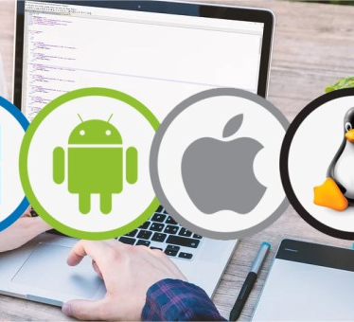
What is an Operative System?
An operating system is a set of programs that allows us to manage memory, disk, information storage media and the different peripherals or resources of our computer, such as the keyboard, mouse, printer, network card, among others.

Slide 3

What is the Operating System for?
Operating systems use images and buttons to be able to communicate with the computer in a simple and easy way to tell our computer what we want to do at all times.

Slide 4
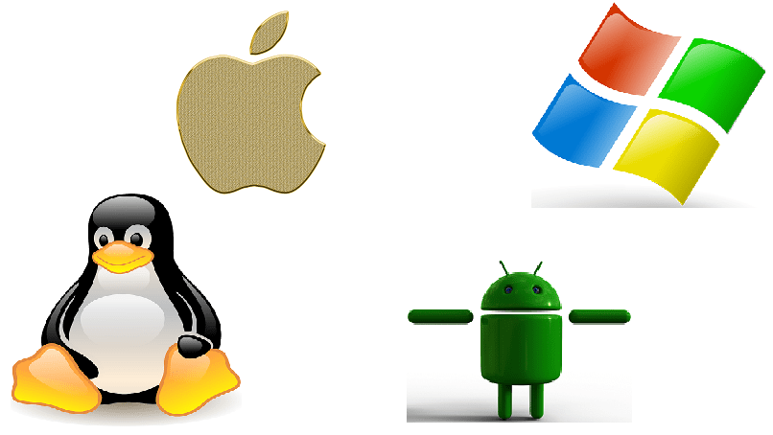
Types of Operating Systems
At the user level of a PC, we can say that there are two types of Operating Systems: OS for PC and OS for Mobile Phones.
for example:
we have the following operating systems:
android
windows
mac
linux

Slide 5
Mobile Operating Systems
Finally I will give some examples of operating systems in mobile phones.
Some operating systems could be the following:
Windows mobile
Android
Mac
and some more based on linux .

Slide 6
Sources:
https://desarrollarinclusion.cilsa.org/tecnologia-inclusiva/que-es-un-sistema-operativo/#:~:text=Un%20sistema%20operativo%20es%20un,placa%20de%20red%2C%20entre%20otros.
https://www.ecured.cu/Sistema_operativo

